Slide 1
Test Complete

Slide 2
Course Objectives
Having knowledge about tool.
Understanding how the tool works.
Being able to use tool to record, playback and enhance some simple scripts.

Slide 3
AGENDA
1
Introduction
2
User Interface
3
Keyword Tests
4
Script Tests
Integration
5

Slide 4
Introduction
A product of SmartBear Ltd.
It’s a charged tool with 1 month free trial
An automated testing environment for a wide range of application types and technologies:
Windows, .NET, WPF, Visual C++, Visual Basic, Delphi, C++Builder,
Java Web applications and services
Functional and Unit Testing
Support for daily regression testing with : data-driven testing, distributed testing
Create tests by recording them or editing test commands in TestComplete panels and editors
TestComplete recognizes objects and controls in tested applications and
offers special commands for simulating user actions with them
TestComplete offers specific checkpoints that let you easily verify the application state during the test run.

Slide 5

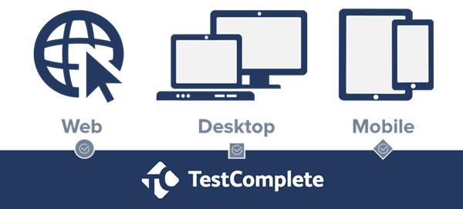

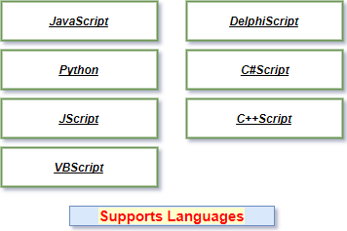

TestComplete Supports

Slide 6
User Interface

Slide 7
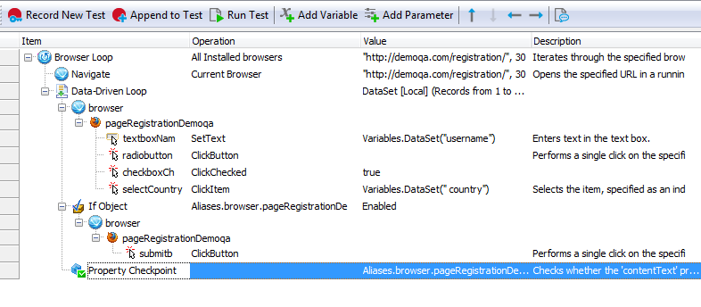
User Interface (Cont.)
Keyword Test Case

Slide 8
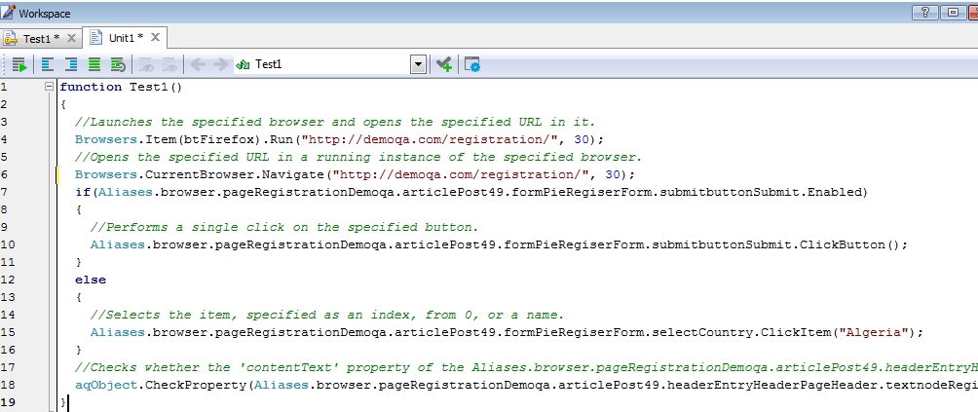
User Interface (Cont.)
Script Mode Test Case

Slide 9
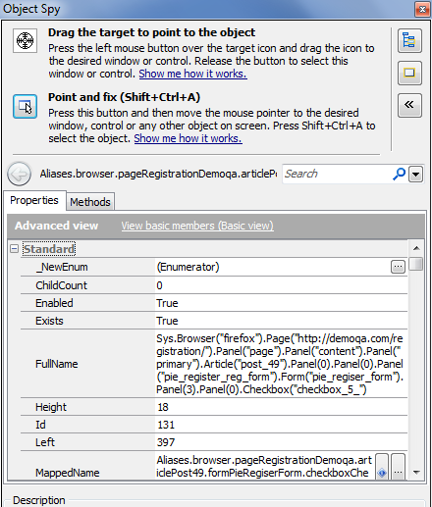
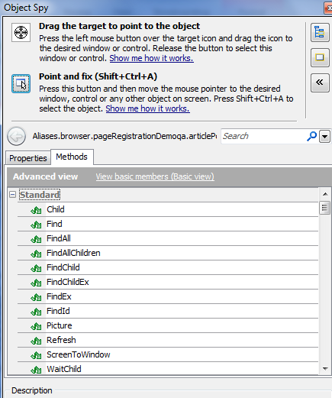
User Interface (Cont.)
Object Spy - Properties
Object Spy - Methods

Slide 10
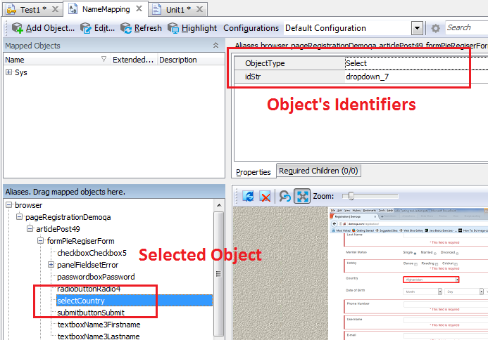
User Interface (Cont.)
Name Mapping Editor

Slide 11
Keyword Tests

Slide 12
Keyword Tests
Basic Common Controls
Checkpoints
Checking Conditions
Loops
Customize Object’s Identifier
Data Driven
Cross Browsers Testing

Slide 13
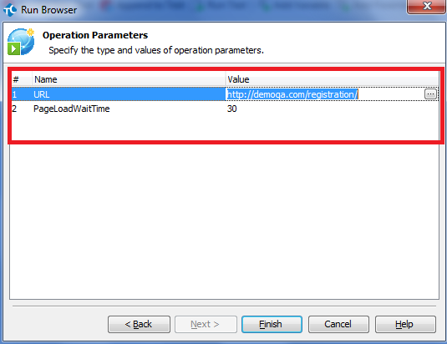
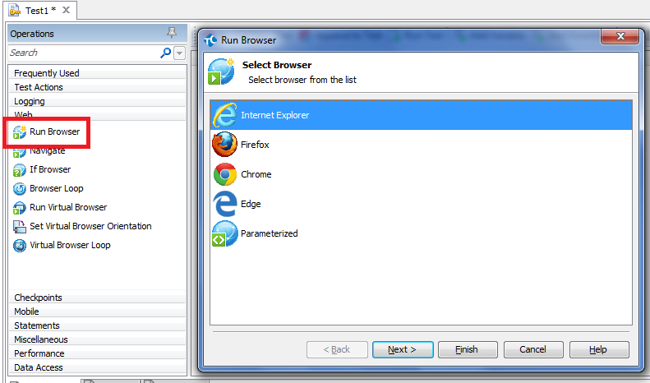
Keyword Test – Basic Controls
Run Browser

Slide 14
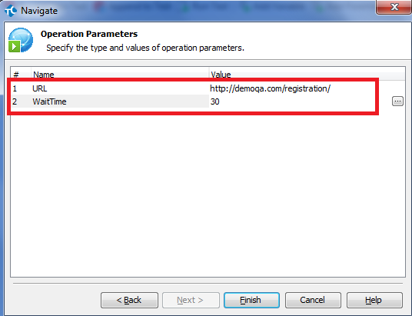
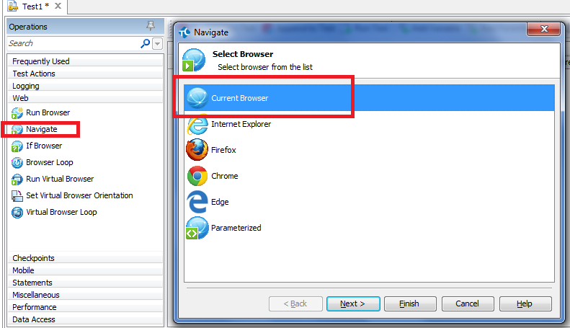
Keyword Test – Basic Controls
Navigate

Slide 15
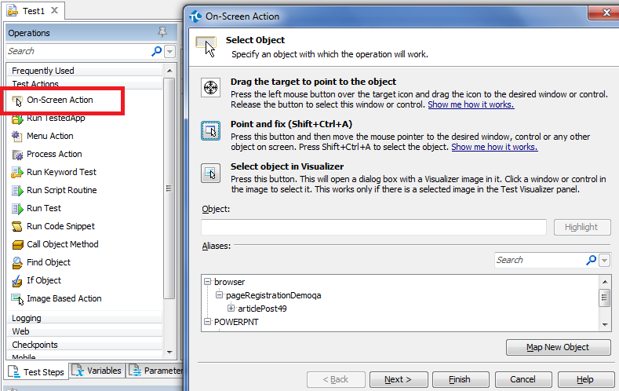
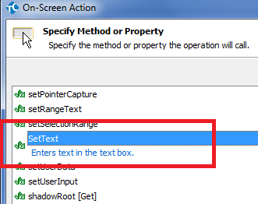
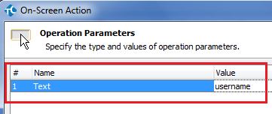
Keyword Test – Basic Controls
TextBox Coltrol
Operations -> On-Screen Actions
-> Select Object -> SetText Action
-> Select Inputted Text -> Finish

Slide 16
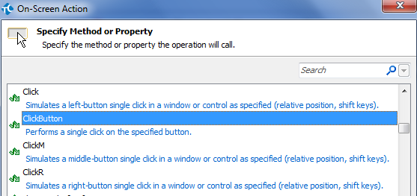
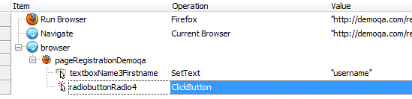
Keyword Test – Basic Controls
Radio Button
Operations -> On-Screen Actions
-> Select Object -> Click Actions
-> No Parameters -> Finish

Slide 17
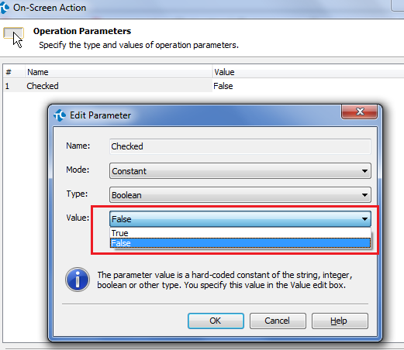
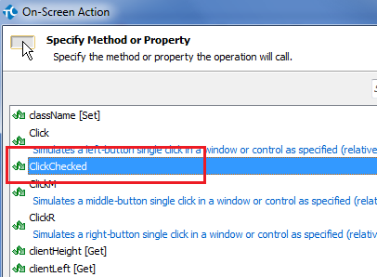
Keyword Test – Basic Controls
Checkbox
Operations -> On-Screen Actions
-> Select Object -> ClickChecked
-> Check/ Uncheck -> Finish
If True: Check this checkbox
If False: Un-check this checkbox

Slide 18
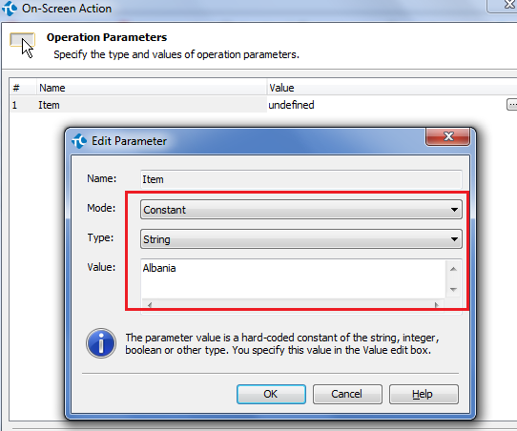
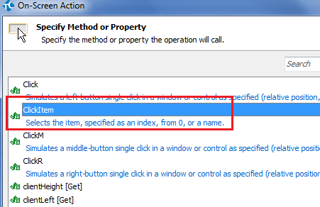
Keyword Test – Basic Controls
Dropdown
Operations -> On-Screen Actions
-> Select Object -> ClickItem
-> No Parameters -> Finish
Select an item by its index
Select an item by its value

Slide 19
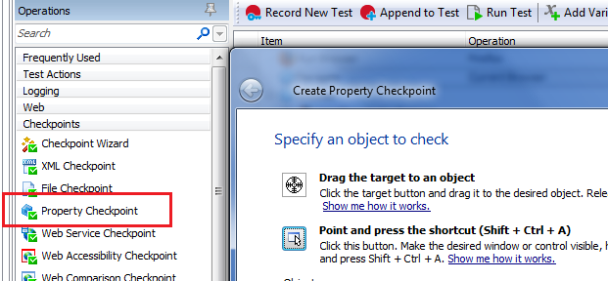
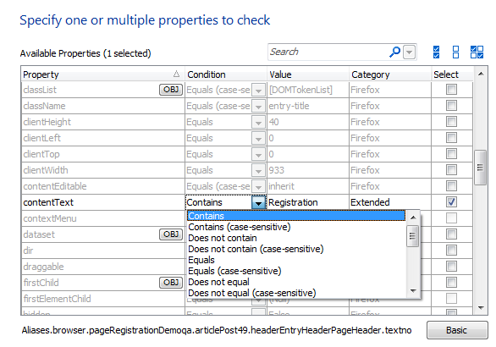
Keyword Test – Checkpoints
Operations -> Checkpoints
-> Property Checkpoint -> Select Object
-> Select Properties to check
-> Select Compare types
-> Finish

Slide 20
Keyword Test – Condition Checking
Exists
Does not exist
Enabled
Disabled
Visible
Invisible
Checked/ Not Checked
…

Slide 21
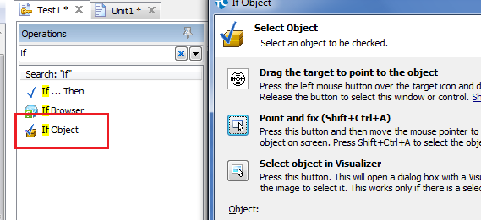
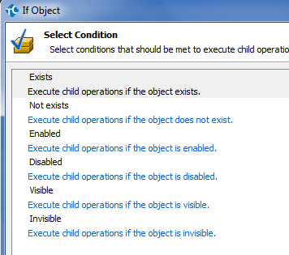
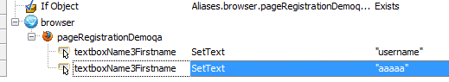
Keyword Test – Condition Checking (Cont.)
If Object
<This operation can check only limited object states>
Operations -> If Object
-> Select Object
-> Select Condition to check
-> Add steps following <If Object>
1
2
3

Slide 22
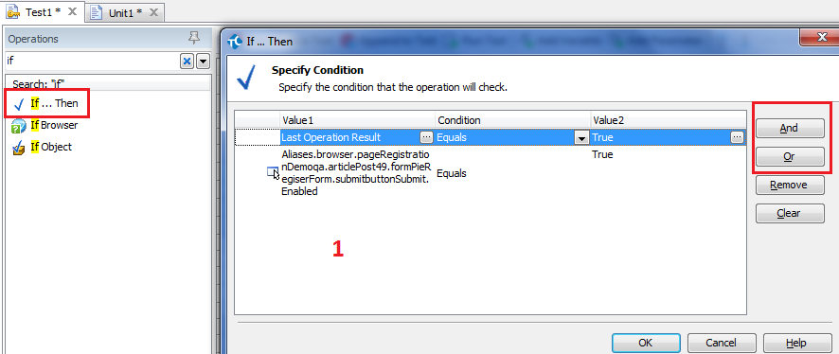
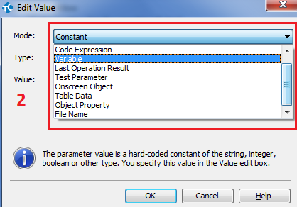
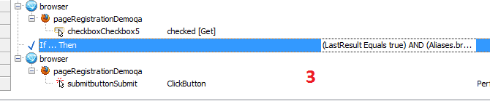
Keyword Test – Condition Checking (Cont.)
If Then
<This operation can combine multiple conditions at once>
Operations -> If Then
-> Select Object
-> Select Condition to check
-> Add steps following <If Object>

Slide 23
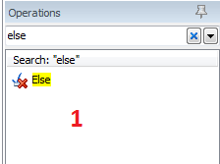
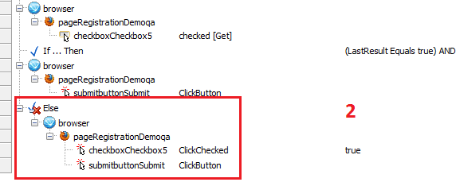
Keyword Test – Condition Checking (Cont.)
Else
Operations -> Else
-> Add steps following <Else>

Slide 24
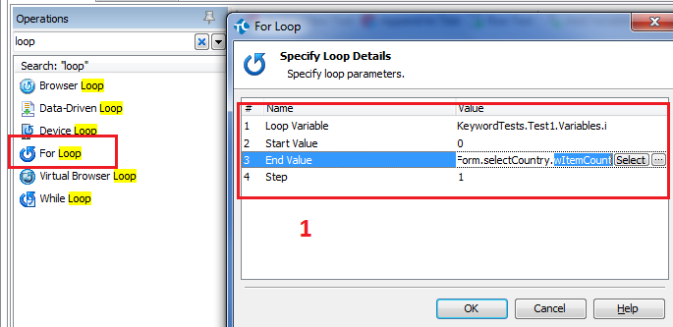
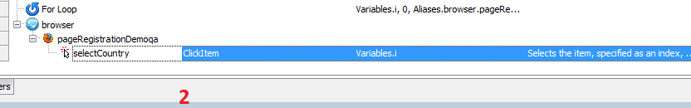
Keyword Test – Loops
Loops
Operations -> For Loop
-> Add Parameters
For( int I = 0; i< length; i++)
-> Add inside loop statements

Slide 25
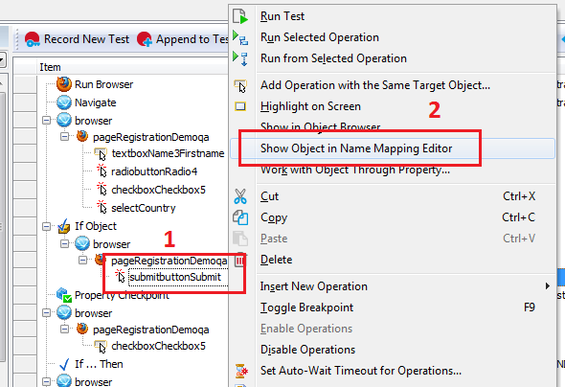
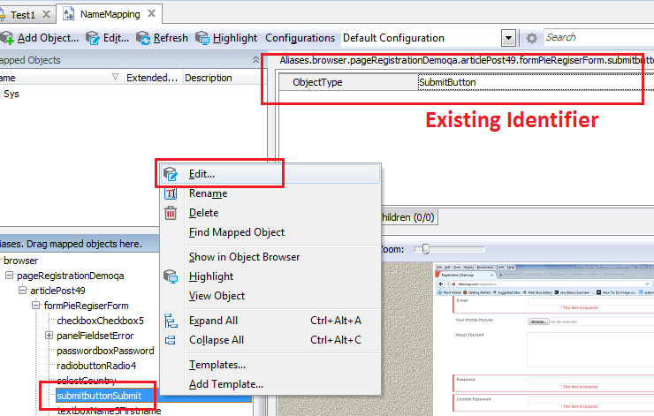
Keyword Test – Customize Object’s Identifier

Slide 26
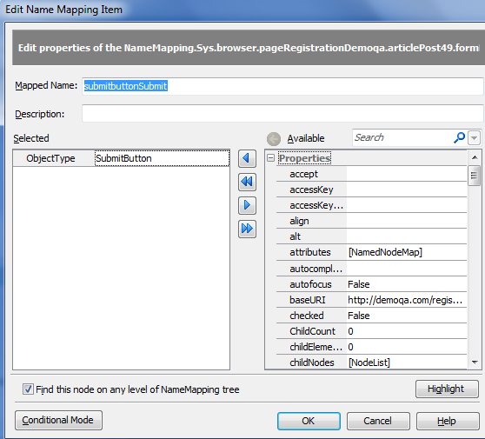
Keyword Test – Customize Object’s Identifier (Cont.)
Recommend:
idStr
Name
ObjectIdentifier
tagName
Type
Value
innerText

Slide 27
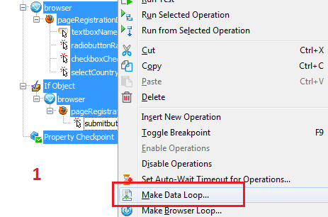
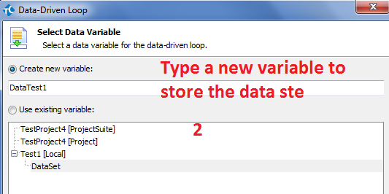
Keyword Test – Data-Driven Testing
Select the code block should use for Data-Driven Testing
Enter a new Name for Data Set

Slide 28
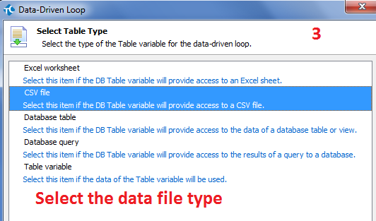
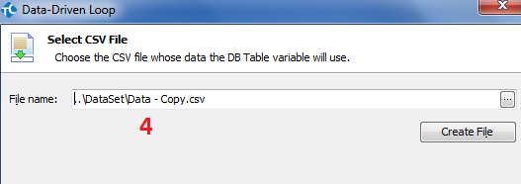
Keyword Test – Data-Driven Testing (Cont.)
Select data file type
Locate to the Data file

Slide 29
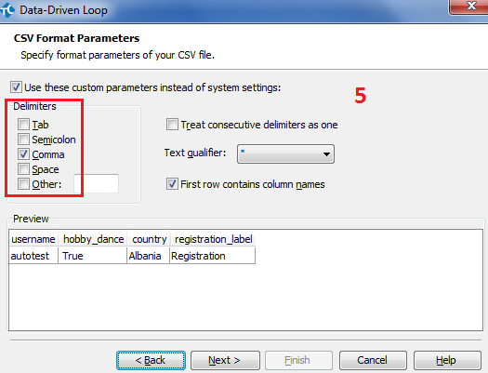
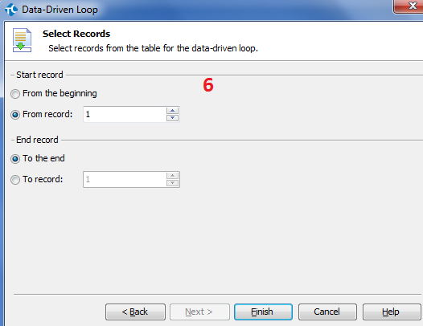
Keyword Test – Data-Driven Testing (Cont.)
Select Delimiters
Select Record Start/End

Slide 30
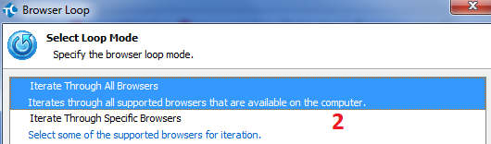
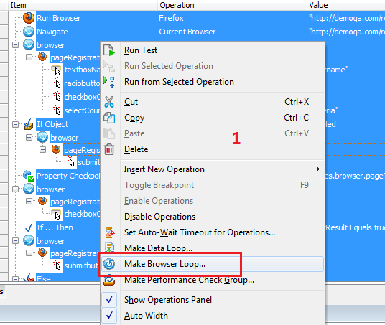
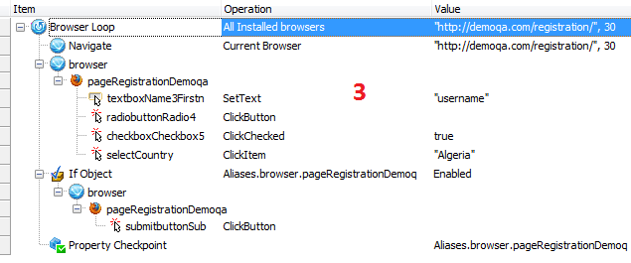
Keyword Test – Cross Browser Testing

Slide 31
Script Tests

Slide 32
Script Tests (Cont.)
Open Browsers
Browsers.Item(btIExplorer).Run();
Browsers.Item(btFirefox).Run("http://demoqa.com/registration/", 30);
Browser Type:
btChrome
btEdge
btFirefox
btExplorer
Navigate
Browsers.CurrentBrowser.Navigate("https://google.com");

Slide 33
Script Tests (Cont.)
Locate Elements - <Find> method
Example: Sys.Browser("*").Page("http://demoqa.com/registration/").Find("idStr", "name_3_firstname", 1000, false);
Parameter:
Param1<String>: Property Name
Param2<String>: Property Value
Param3<Integer>: Search in Depth value (default: 1)
Param4<Boolean>: Refresh when not found

Slide 34
Script Tests (Cont.)
Locate Elements (Cont.) - <FindChildByXPath> method
Example: Sys.Browser("*").Page("http://demoqa.com/registration/").FindChildByXPath("//*[@id='name_3_firstname']");
Parameter:
Param1<String>: The xpath of element
Locate Elements (Cont.) - <QuerySelector> method
Example: Sys.Browser("*").Page("http://demoqa.com/registration/") .QuerySelector("input#name_3_firstname");
Parameter:
Param1<String>: The css selector of element

Slide 35
Script Tests (Cont.)
TextBox Control
SetText:
Example: Sys.Browser("*").Page("http://demoqa.com/registration/").FindChildByXPath("//*[@id='name_3_firstname']").SetText("phongtrinh");
Parameter:
Param1<String>: The inputted text

Slide 36
Script Tests (Cont.)
Radio Button
Click:
Example:
var singleChkXpath = "//label[text()='Single']/following-sibling::input[1]";
Sys.Browser("*").Page("http://demoqa.com/registration/").FindChildByXPath(singleChkXpath).Click();

Slide 37
Script Tests (Cont.)
Checkbox
Select/ De-Select checkbox:
Example:
var danceChkXpath = "//label[text()=‘Dance']/following-sibling::input[1]";
// Select the checkbox Sys.Browser("*").Page("http://demoqa.com/registration/").FindChildByXPath(danceChkXpath). ClickChecked(true);
// De-Select the checkbox Sys.Browser("*").Page("http://demoqa.com/registration/").FindChildByXPath(danceChkXpath). ClickChecked(false);

Slide 38
Script Tests (Cont.)
Checkbox (Cont.)
Get Checkbox’s status:
Example:
var danceChkXpath = "//label[text()=‘Dance']/following-sibling::input[1]";
var status = Sys.Browser("*").Page("http://demoqa.com/registration/").FindChildByXPath(danceChkXpath).checked;
Status = True or False <Boolean>

Slide 39
Script Tests (Cont.)
Dropdown
Select An Item:
Example:
// Select by Value Sys.Browser("*").Page("http://demoqa.com/registration/").Find("idStr ", "dropdown_7", 10000, false).ClickItem("Albania");
// Select by Index
Sys.Browser("*").Page("http://demoqa.com/registration/").Find("idStr ", "dropdown_7", 10000, false).ClickItem(3);

Slide 40
Script Tests (Cont.)
Dropdown (Cont.)
var country = Sys.Browser("*").Page("http://demoqa.com/registration/").Find("idStr", "dropdown_7", 10000, false);
// Count item
var count = country.wItemCount;
Log.Message(count);
// Get the selected item
var selectedItem = country.wText;
Log.Message(selectedItem);

Slide 41
Script Tests (Cont.)
Button / Link
Click:
Example:
Sys.Browser("*").Page("http://demoqa.com/registration/").FindChildByXPath("//input[@name='pie_submit']").Click();

Slide 42
Script Tests (Cont.)
Checkpoints
Systax:
aqObject.CheckProperty(object, property, condition, expectValue, isSensitive);
Params:
Param1: object <Object>: The checked element
Param2: property<String>: The checked property
Param3: condition<Integer>: The checking condition
cmpEqual / cmpNotEqual
cmpContains / cmpNotContains
cmpStartsWith / cmpEndsWith
cmpIn / cmpNotIn
Param4: expectValue <String, Integer>: The expected value
Param5: isCasensitive <Boolean>: Accept sensitive case or not

Slide 43
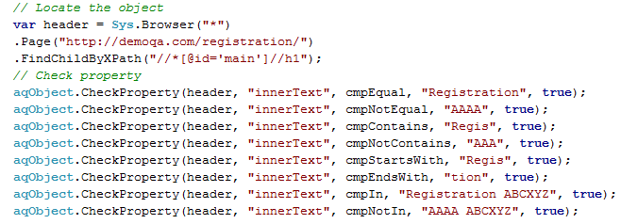
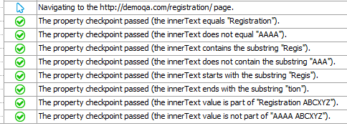
Script Tests (Cont.)
Checkpoints (Cont.)
Example
Result

Slide 44
Integration

Slide 45
Integration
Source Control System
SVN
Git
Mercurial
TFS
Issue-Tracking System
Axosoft OnTime
Atlassian JIRA
Mozilla Bugzilla
SmartBear QAComplete

Slide 46
Integration (Cont.)
Microsoft Visual Studio
Run unit tests created with Visual Studio as part of your TestComplete projects
Run TestComplete tests directly from your MSBuild projects
Integrate TestComplete tests into your Visual Studio test projects and include them in your application's lifecycle managed by Visual Studio and Team Foundation tools
CI tools
Jenkins
Bamboo
VSTS

Slide 47
Reference
SmartBear Documentation: https://support.smartbear.com/testcomplete/docs/

